Slide 1

Project Review
Project Title: PHISHING URL CLASSIFICATION USING MACHINE LEARNING
S.No | Regd.No | Student Name
1 | 20A81A05I3 | SHAIK SUBHAN SAHEB
Project Guide:
Mr. M. S. Kumar ReddyMTech,(Ph.D),Asst.Prof.

Slide 2
Table of Contents:
Abstract
Literature Survey
Problem Statement
Proposed System
Objective
Requirement Analysis
Functional Requirements
Non-Functional Requirements
Software Requirements
Hardware Requirements
System Architecture
Methodology
Implementation
Result Analysis
Attainment Objective
Future scope of Project

Slide 3
ABSTRACT
The exponential growth of digital world providing great opportunities for both positive advancements and malicious activities. While the internet facilitates seamless communication, collaboration, and innovation, it has also become a breeding ground for cyber threats, with phishing attacks being a prominent concern. Phishing, a deceptive practice where attackers masquerade as trustworthy entities to trick individuals into revealing sensitive information, poses a significant risk to online security.
In response to the ever-evolving landscape of cyber threats, this project introduces a cutting-edge approach to identify phishing attack URLs using machine learning. Leveraging the power of machine learning, the proposing Phishing URL Classification System aims to dynamically adapt to the latest tactics employed by malicious actors. By extracting and analysing a diverse range of features from URLs, including lexical, structural, and content-based attributes, the system enhances its ability to distinguish between legitimate and phishing URLs. I am working to train the Machine Learning model over 10,000 distinct URLs to make the system more accurate.

Slide 4
LITERATURE SURVEY
S.No. | Authours | Paper Title | Publication | Methodology | Conclusion
1 | M. Zabihimayvan and D. Doran | Fuzzy Rough Set Feature Selection to Enhance Phishing Attack Detection | 2019 IEEE International Conference on Fuzzy Systems (FUZZ-IEEE), New Orleans, LA, USA, 2019 | Fuzzy Rough Set Feature Selection | In this study the concluded that selection of URL features are main to classify the URLs effectively.
2 | I. Kara, M. Ok and A. Ozaday | Characteristics of Understanding URLs and Domain Names Features: The Detection of Phishing Websites with Machine Learning Methods | IEEE Access, vol. 10, pp. 124420-124428, 2022 | Random Forest Algorithm | In this study, they concluded that Random Forest algorithm is providing effective results.

Slide 5
LITERATURE SURVEY
S.No. | Authours | Paper Title | Publication | Methodology | Conclusion
3 | S. Parekh, D. Parikh, S. Kotak and S. Sankhe | A New Method for Detection of Phishing Websites: URL Detection | International Conference on Inventive Communication and Computational Technologies, Coimbatore, 2018 | Random Forest Algorithm and RStudio | In this study, they worked on Random Forest algorithm to get accuracy around 90%.
4 | M. M. Vilas, K. P. Ghansham, S. P. Jaypralash and P. Shila | Detection of Phishing Website Using Machine Learning Approach | 2019 4th ICEECCOT, Mysuru, India, 2019 | WEKA, Rstudio and SVM | In this study, they concluded that the SVM is able to identify the URLs. WEKA, Rstudio are helpful to extract features

Slide 6
LITERATURE SURVEY
S.No. | Authours | Paper Title | Publication | Methodology | Conclusion
5 | N. F. Abedin, R. Bawm, T. Sarwar, M. Saifuddin, M. A. Rahman and S. Hossain | Phishing Attack Detection using Machine Learning Classification Techniques | 2020 3rd International Conference on Intelligent Sustainable Systems (ICISS), Thoothukudi, India, 2020 | KNN, Logistic Regression and Random Forest Algorithm | In this paper, the performance of three widely used machine learning classifiers are compared. Among these three classifiers, random forest performance is the highest.

Slide 7
PROBLEM STATEMENT
Phishing attacks via URLs continue to pose a significant threat to cybersecurity. Existing methods for detecting phishing URLs are often insufficient due to the dynamic nature of these attacks and the large volume of websites to monitor. Manual inspection and rule-based approaches are labor-intensive and prone to errors. Therefore, there is a critical need for automated and accurate techniques to detect phishing URLs efficiently. This study aims to address this challenge by developing machine learning-based approaches for robust phishing URL classification, mitigating the risks associated with online fraud and data breaches.

Slide 8
PROPOSED SYSTEM
The proposed system aims to create a machine learning (ML) solution for identifying phishing URLs. With a dataset comprising 10,000 records, the ML model will undergo comprehensive training to effectively differentiate between legitimate and malicious URLs. Once deployed across diverse digital platforms, the system will continuously analyze URLs in real-time, promptly alerting users to potential phishing risks. To maximize accessibility, the ML-based detection system will be packaged into an API, facilitating effortless integration into existing software frameworks and bolstering overall cybersecurity defenses.

Slide 9
OBJECTIVE
Develop a robust machine learning model capable of accurately detecting phishing URLs.
Train the model using a diverse dataset to ensure comprehensive coverage of phishing patterns.
Design and deploy an API for seamless integration of the phishing detection system into various digital platforms.

Slide 10
REQUIREMENT ANALYSIS: FUNCTIONAL REQUIREMENTS
System should collect URL from user
System should get features from URL and classifies its class
System has to render the predicted output to user

Slide 11
REQUIREMENT ANALYSIS: NON-FUNCTIONAL REQUIREMENTS
User friendly
System should provide better accuracy
To perform with efficient response time
Availability
Scalability

Slide 12
REQUIREMENT ANALYSIS: SOFTWARE REQUIREMENTS
Coding Language Python3
Backend Framework Django
Frontend Technology React JS

Slide 13
REQUIREMENT ANALYSIS: HARDWARE REQUIREMENTS
Server Side Requirements
Processor Support i3 onwards
RAM 4GB
Client Side Requirements
Any device that connected to active internet and has browser/terminal

Slide 14
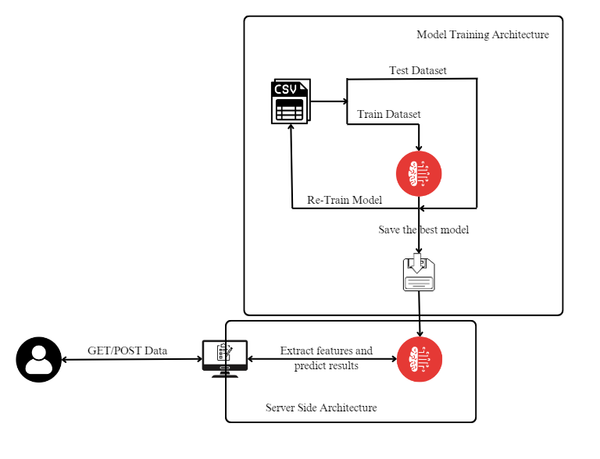
SYSTEM ARCHITECTURE

Slide 15
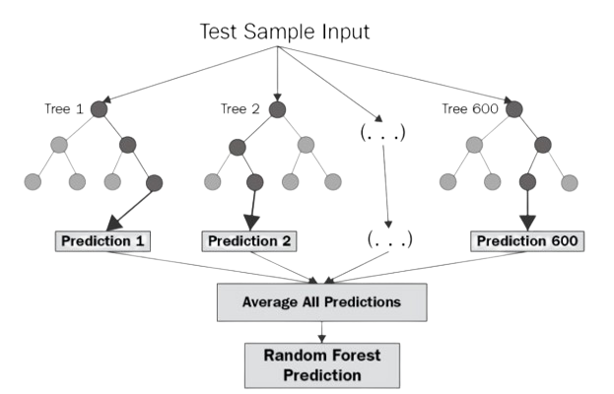
METHODOLOGY
Random Forest Algorithm :
Step 1: In Random forest n number of random records are taken from the data set having k number of records.
Step 2: Individual decision trees are constructed for each sample.
Step 3: Each decision tree will generate an output.
Step 4: Final output is considered based on Majority Voting or Averaging for Classification and regression respectively.

Slide 16
IMPLEMENTATION
Collecting Dataset
The dataset is collected from https://research.aalto.fi/en/datasets/phishstorm-phishing-legitimate-url-dataset, which has around 90K records collected till 2014. It contains URLs and their labels, whether it is phishing or not with 12 features.
Pre-processing the Dataset
Pre-processing of dataset includes excluding the pre-provided features and then checking every URL to its availability. And then new features has been generated from the URLs.
Model Training
Now the pre-processed data is trained on various machine learning models and pickled the best Random Forest one.

Slide 17
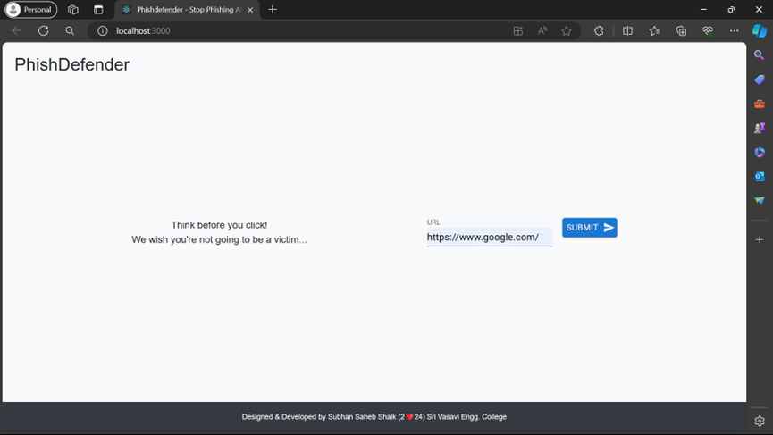
RESULT ANALYSIS

Slide 18
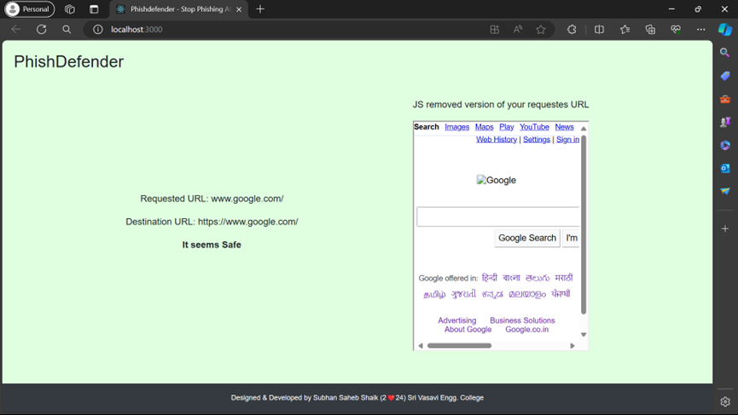
RESULT ANALYSIS

Slide 19
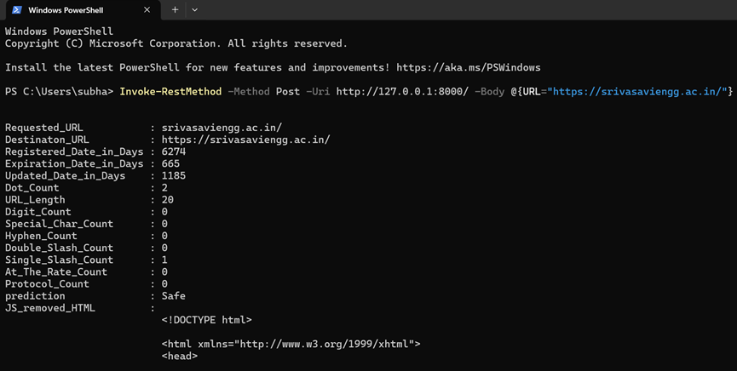
RESULT ANALYSIS

Slide 20
ATTAINMENT OF OBJECTIVE
The main objective of developing easy to use interface to access the machine learning estimator is developed.
It could be accessed through any Terminal or any Programming language that has ability to support API and had active internet connection.

Slide 21
FUTURE SCOPE OF PROJECT
This project can be scaled in future by implementing advanced Artificial Intelligence concepts like Natural Language Processing.
And we could also consider the content of the webpage instead of taking only URL structure and its features.

Slide 22
THANK YOU

